Slide 1
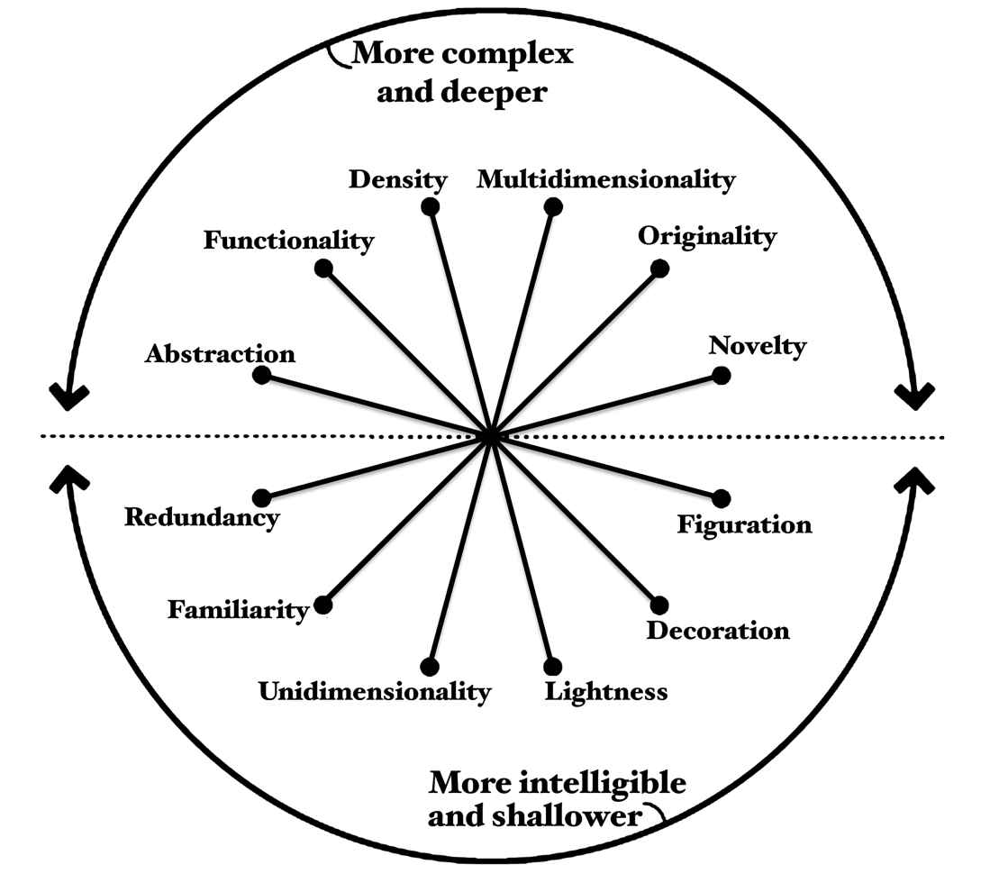
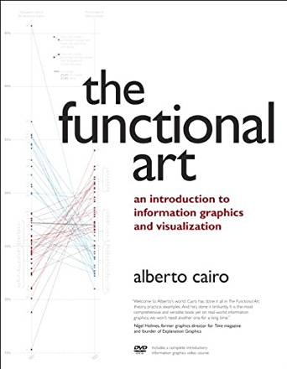
Visualization Wheel
Alberto Cairo; the functional art
Notes:
Image on the left: A visualization wheel that displays two regions: the top half of the wheel displays terms for complex and deeper visual characteristics and the bottom half of the wheel displays terms for more intelligible and shallower visual characteristics. There are six pairs of characteristics that are opposite to one another, with the first characteristic falling in the complex and deeper region and the second characteristic falling in the more intelligible and shallower region: Abstraction and Figuration, Functionality and Decoration, Density and Lightness, Multidimensionality and Unidimensionality, Originality and Familiarity, Novelty and Redundancy.
Image on the right: Alberto Cairo’s book cover image, The functional art : an Introduction to information graphics and visualization
[source] Cairo, A. (2013). The functional art: An introduction to information graphics and visualization. Berkley, CA: New Riders.

Slide 2
Visualization Wheel Dimensions
Abstraction – Figuration
Boxes and charts (abstraction) or real-world physical objects (figuration)

Slide 3
Visualization Wheel Dimensions
Abstraction – Figuration
Boxes and charts (abstraction) or real-world physical objects (figuration)
Functionality – Decoration
No embellishments (functionality) or artistic embellishments (decoration)

Slide 4
Visualization Wheel Dimensions
Abstraction – Figuration
Boxes and charts (abstraction) or real-world physical objects (figuration)
Functionality – Decoration
No embellishments (functionality) or artistic embellishments (decoration)
Density – Lightness
Must be studied in depth (density) or understandable at a glance (lightness)

Slide 5
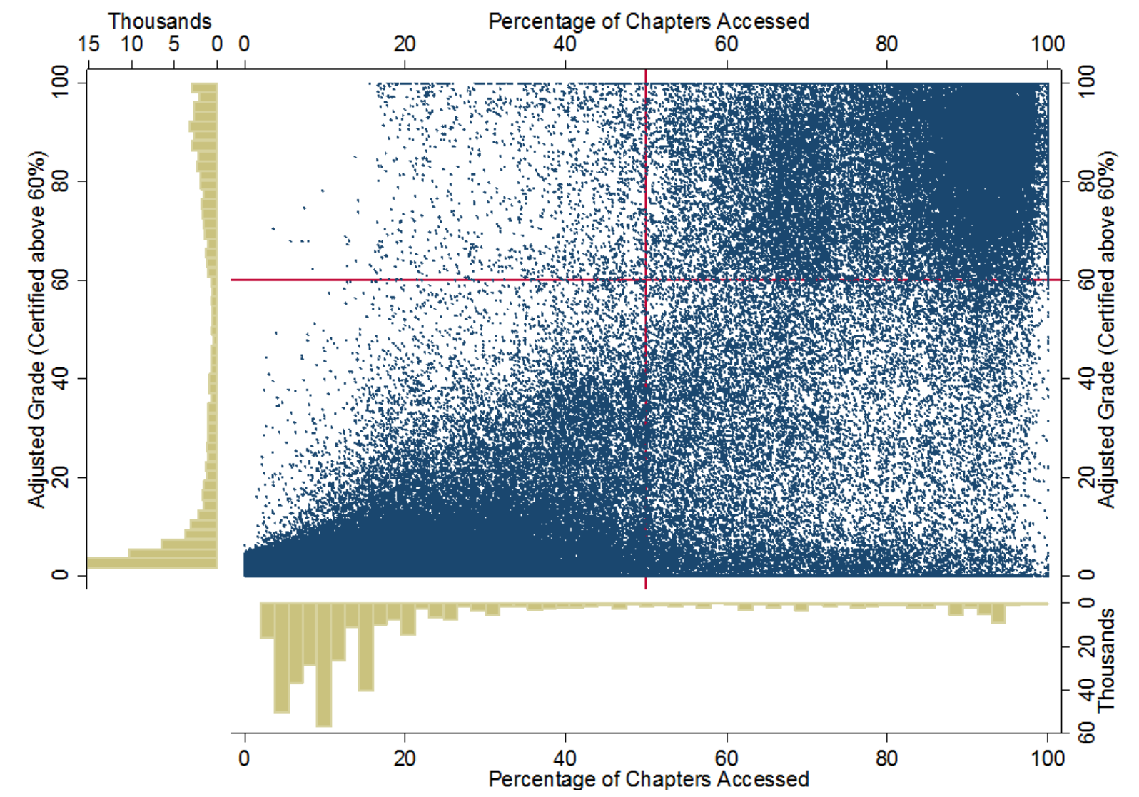
Notes:
Image: A scatterplot with marginal histograms. The X axis shows percentage of chapters accessed in a MOOC course from 0 percent on the left to 100 percent on the right, and the Y axis shows adjusted grades from 0 at the bottom to 100 at the top. The scatter plot maps both of these variables together, with higher density on the bottom left and the top right.
[source] Ho, A. D., Reich, J., Nesterko, S., Seaton, D. T., Mullaney, T., Waldo, J., & Chuang, I. (2014). HarvardX and MITx: The first year of open online courses (HarvardX and MITx Working Paper No. 1). Retrieved February 17, 2017 from https://papers.ssrn.com/sol3/papers.cfm?abstract_id=2381263 for digital copy. (Figure 13, p 31)

Slide 6
Visualization Wheel Dimensions
Multidimensional – Unidimensional
Different aspects of phenomena (multidimensional) or single or few items of phenomenal (unidimensional)

Slide 7

Notes:
Image: A two-dimensional annotated map by Charles Joseph Minard showing the march of Napoleon’s troops into and out of Russia in 1812. The size of the army is shown by the thickness of the upper bar, going from thick to thinner into Russia and in the lower bar, from thin to very thin on their retreat. The direction of their march is also evident through the thinning of the lines. There is other information given by the map, including temperature at given locations, geographical features like rivers and towns, and distance shown in kilometers. The dramatic reduction in the size of the army over time is clearly shown, and upon closer inspection, various factors that contributed to this loss are evident, for example, due to cold temperatures.
[source] “Charles Minard's map of Napoleon's disastrous Russian campaign of 1812.” Retrieved February 17, 2017 https://en.wikipedia.org/wiki/Charles_Joseph_Minard#/media/File:Minard.png

Slide 8
Visualization Wheel Dimensions
Multidimensional – Unidimensional
Different aspects of phenomena (multidimensional) or single or few items of phenomenal (unidimensional)
Originality – Familiarity
Novel methods of visualization (originality) or established and well understood methods of visualization (familiarity)
Novelty – Redundancy
Explaining each item once (novelty) or encoding multiple explanations of the same phenomena (redundancy)

Slide 9
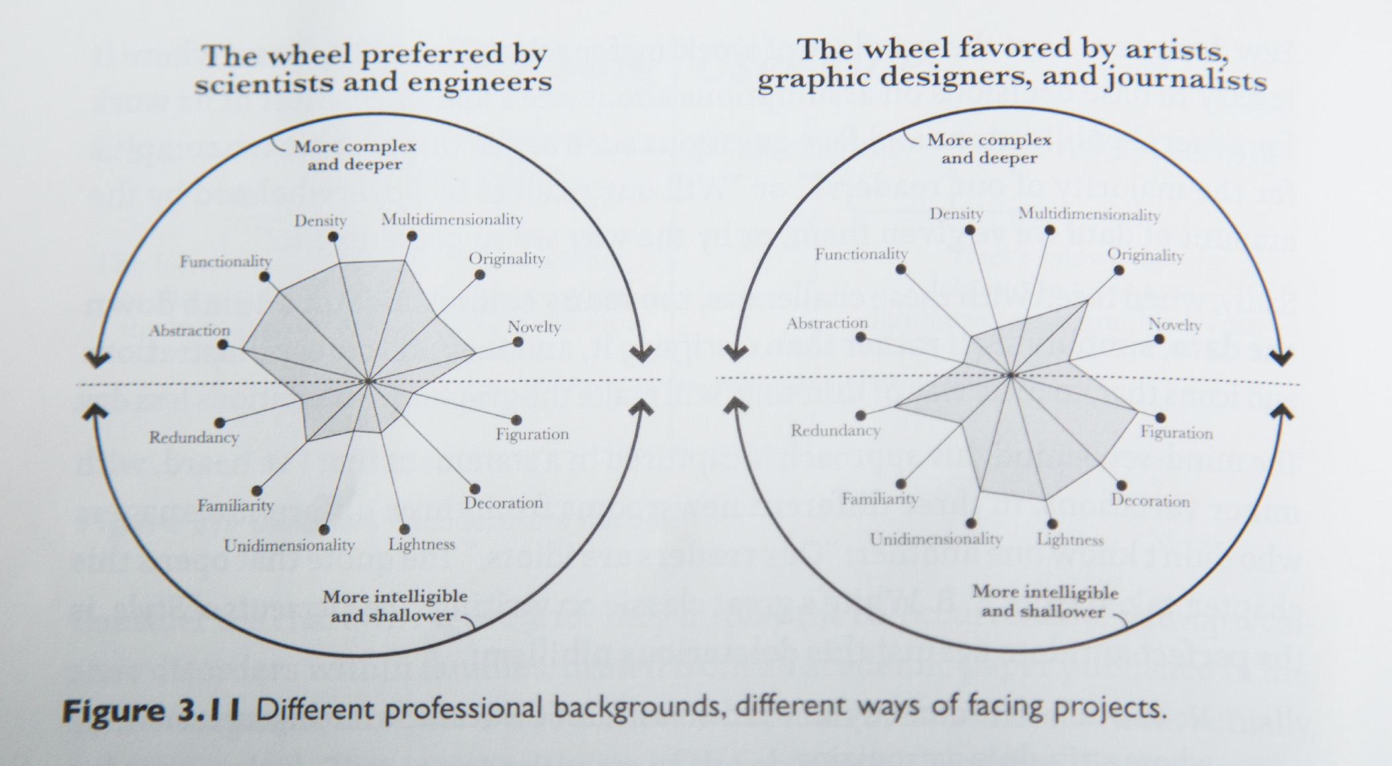
Notes:
Image: Two visualization wheels with identical characteristic labels, but different plotted values. On the left wheel, more emphasis is placed on complex and deeper visualization characteristics, like abstraction, functionality, density, and multidimensionality. Scientists and engineers prefer images that correspond to this wheel.
In the right wheel, the plotted values show more emphasis on intelligible and shallower visualization characteristics, like unidimensionality, lightness, decoration, and figuration. Artists, graphic designers, and journalists prefer images that correspond to this wheel.
[source] Cairo, A. (2013). The functional art: an Introduction to information graphics and visualization. Berkley, CA: New Riders. (Figure 3.11, pp 62)

Slide 10
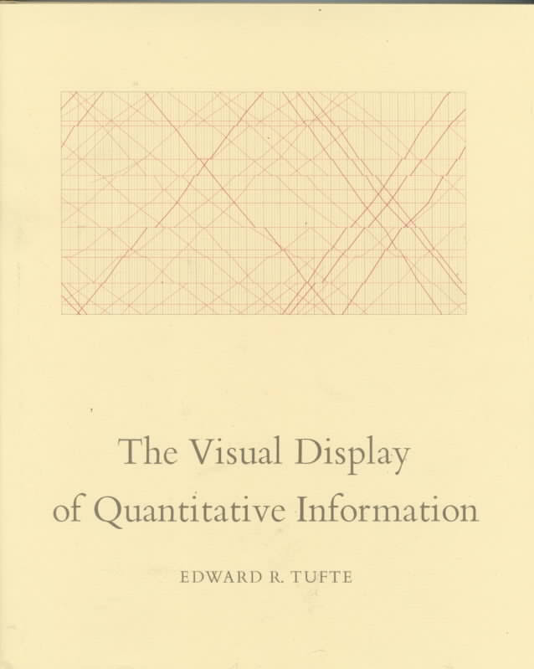
Notes:
Image: Edward R. Tufte’s book cover image, The Visual Display of Quantitative Information
[source] Tufte, E. R. (1985). The Visual Display of Quantitative Information. Cheshire, CT: Graphics Press.

Slide 11
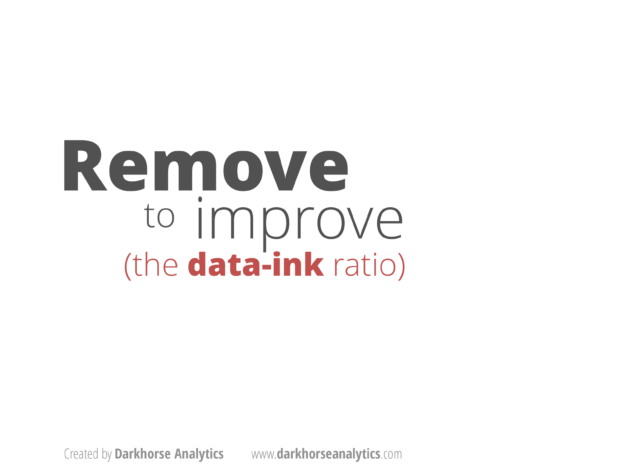

Notes:
Image 1: Text reads “remove to improve (the data-ink ratio)”
Image 2: Logo and URL for www.darkhorseanalytics.com
[source] Retrieved February 17, 2017, from http://www.darkhorseanalytics.com/

Slide 12
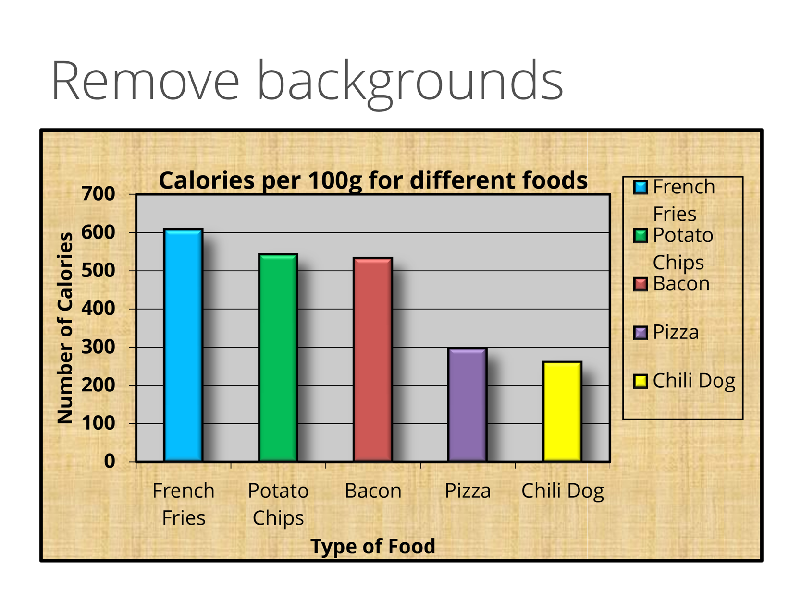
Notes:
Image: A bar graph with background shading, titled Calories per 100 grams for different foods. The Y-axis shows the number of calories, ranging from 0 at the bottom to 700 at the top. The X-axis shows colored bars for five types of food, listed in descending order of the number of calories: French fries, potato chips, bacon, pizza, and chili dog. A key is also shown on the right for all five colors/foods.

Slide 13
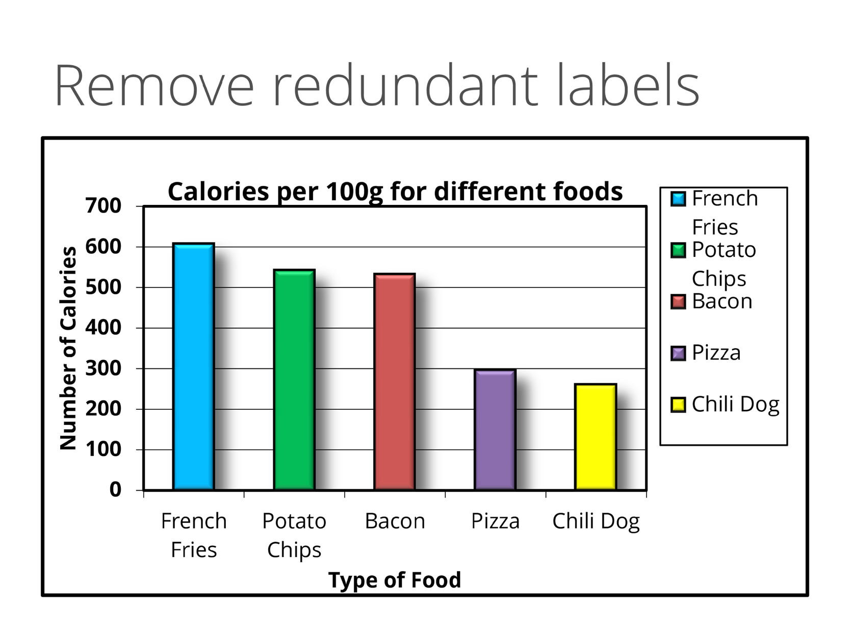
Notes:
Image: Calories per 100 grams for different foods bar graph, with the background colors removed. The Y-axis shows the number of calories, ranging from 0 at the bottom to 700 at the top. The X-axis shows colored bars for five types of food, listed in descending order of the number of calories: French fries, potato chips, bacon, pizza, and chili dog.

Slide 14
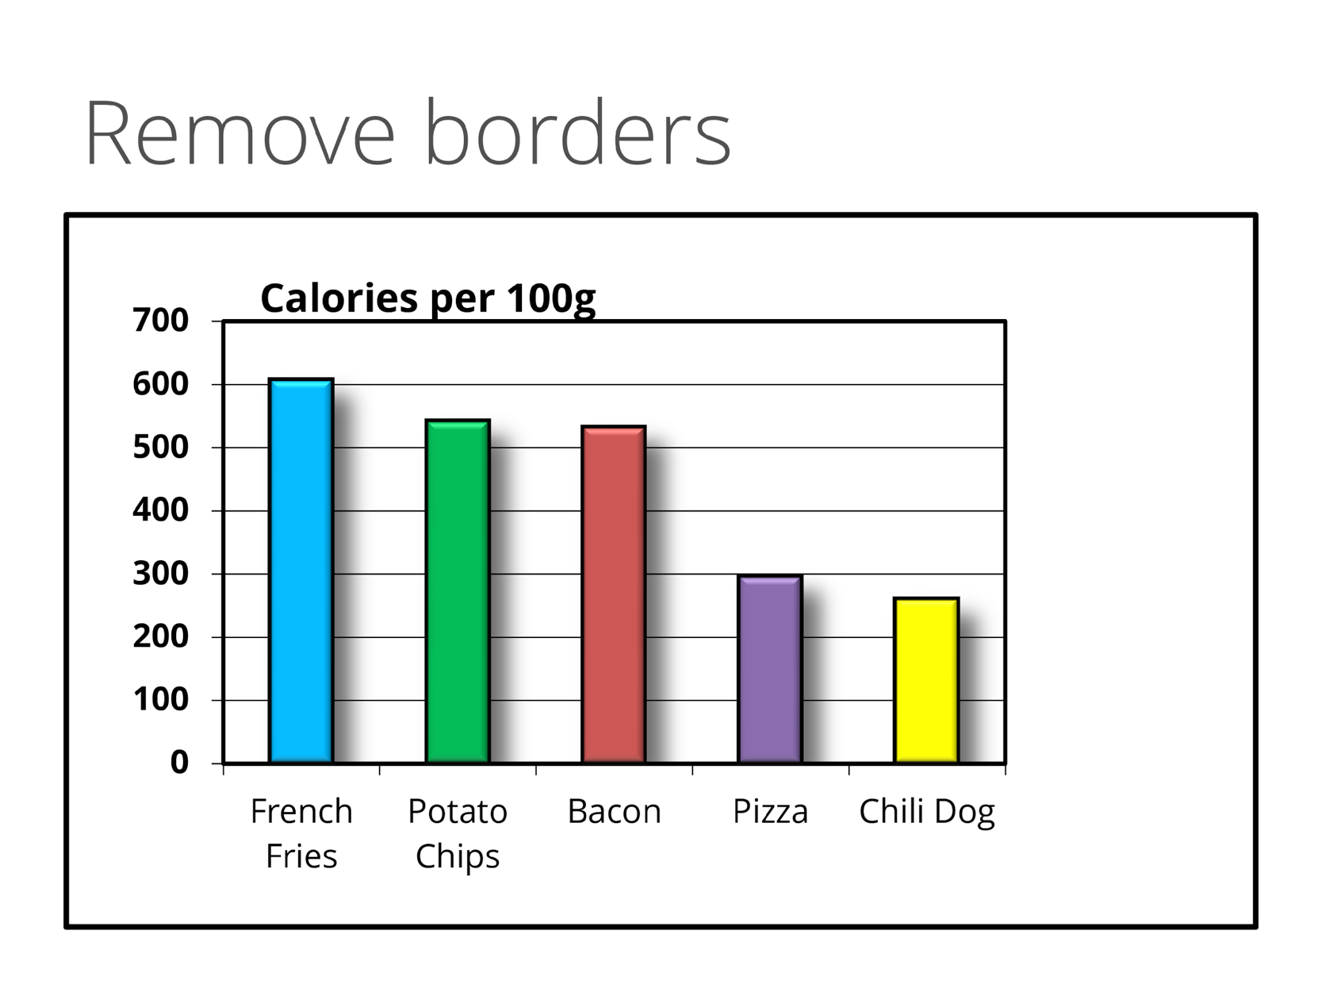
Notes:
Image: Calories per 100 grams for different foods bar graph, with background colors and redundant labels and key removed.
The Y-axis shows the number of calories, ranging from 0 at the bottom to 700 at the top. The X-axis shows colored bars for five types of food, listed in descending order of the number of calories: French fries, potato chips, bacon, pizza, and chili dog.

Slide 15
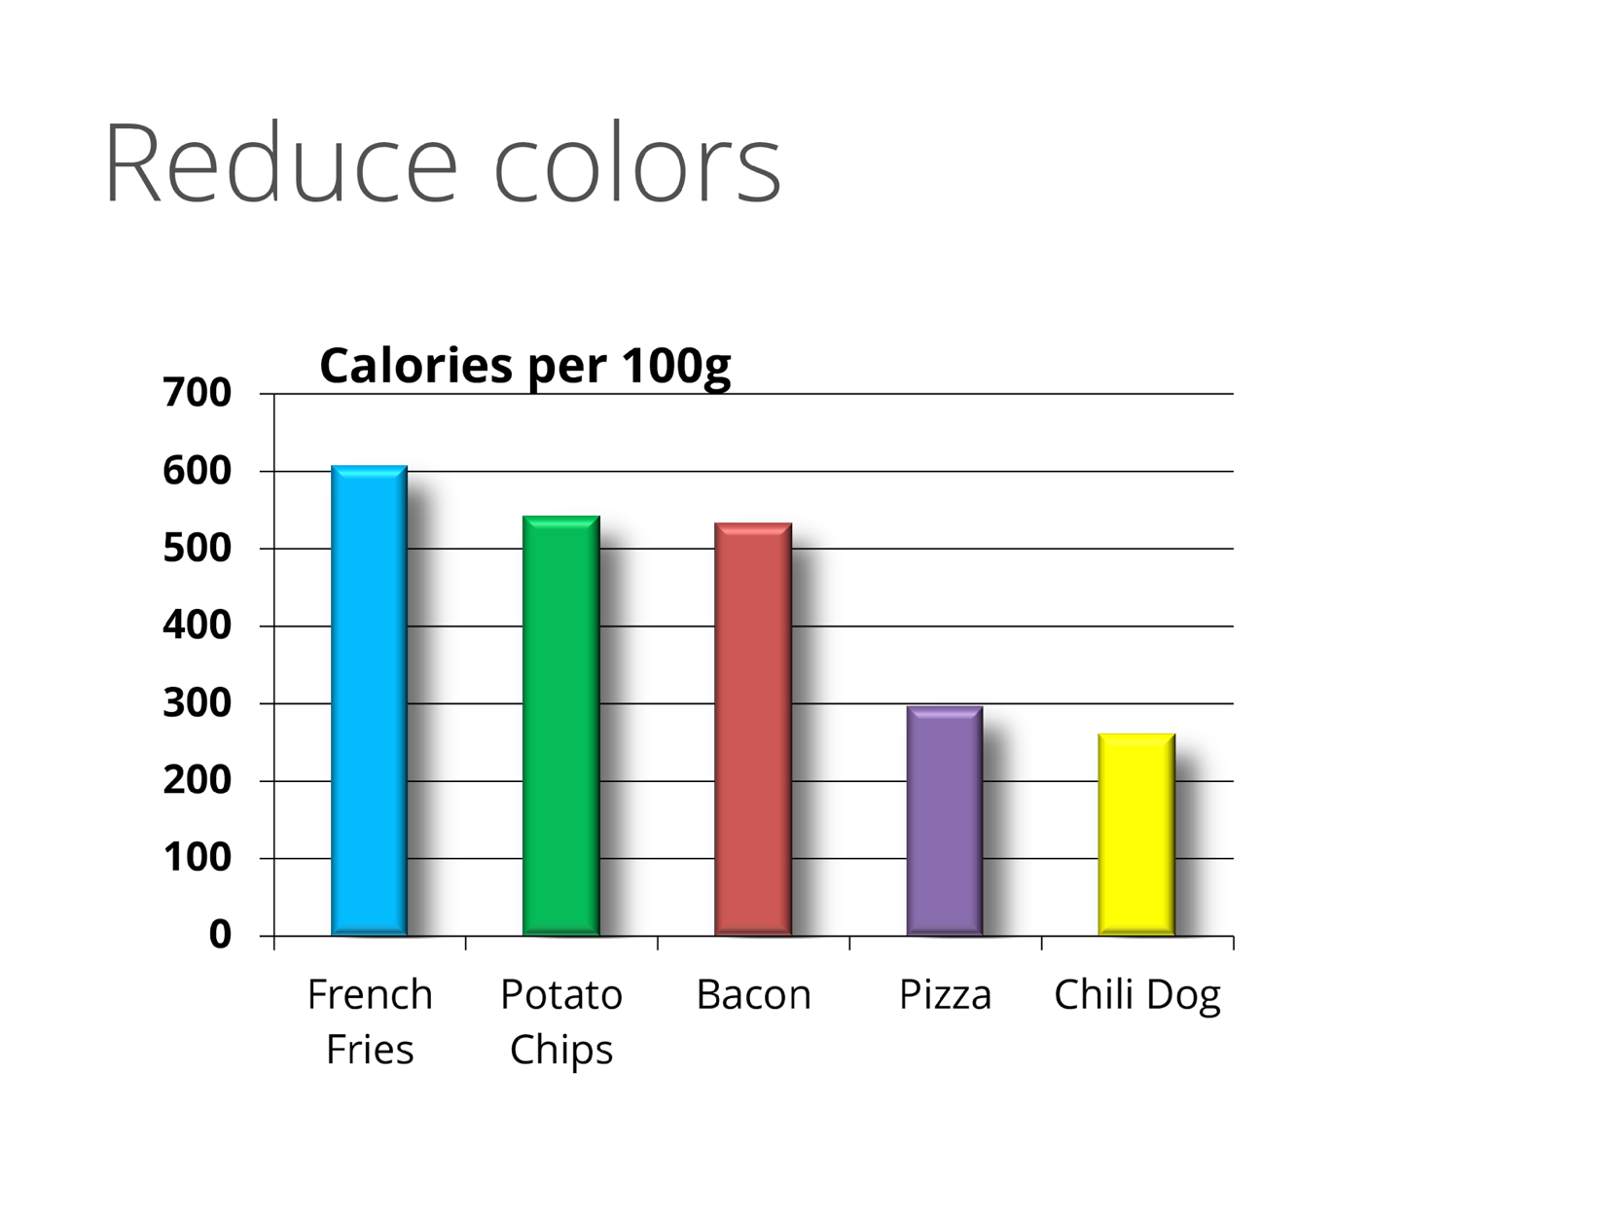
Notes:
Image: Calories per 100 grams for different foods bar graph, with background colors, redundant labels, key, and borders removed.
The Y-axis shows the number of calories, ranging from 0 at the bottom to 700 at the top. The X-axis shows colored bars for five types of food, listed in descending order of the number of calories: French fries, potato chips, bacon, pizza, and chili dog.

Slide 16
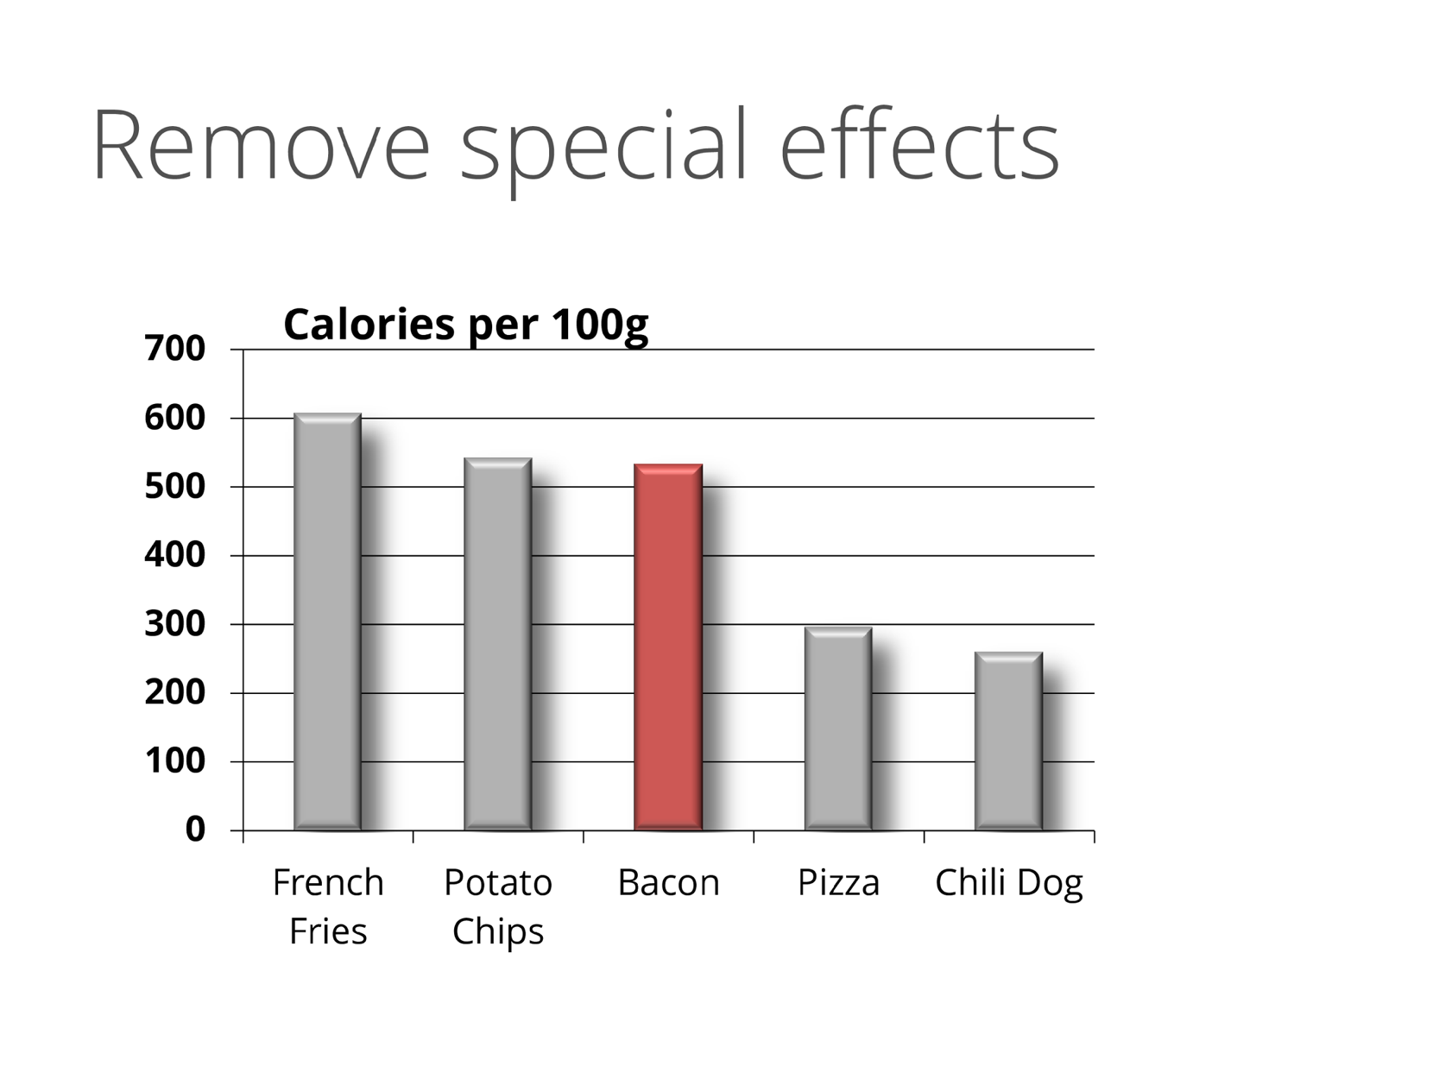
Notes:
Image: Calories per 100 grams for different foods bar graph, with background colors, redundant labels, key, borders, and colors removed.
The Y-axis shows the number of calories, ranging from 0 at the bottom to 700 at the top. The X-axis shows bars for five types of food, listed in descending order of the number of calories: French fries, potato chips, bacon, pizza, and chili dog. The Bacon bar is highlighted in red.

Slide 17
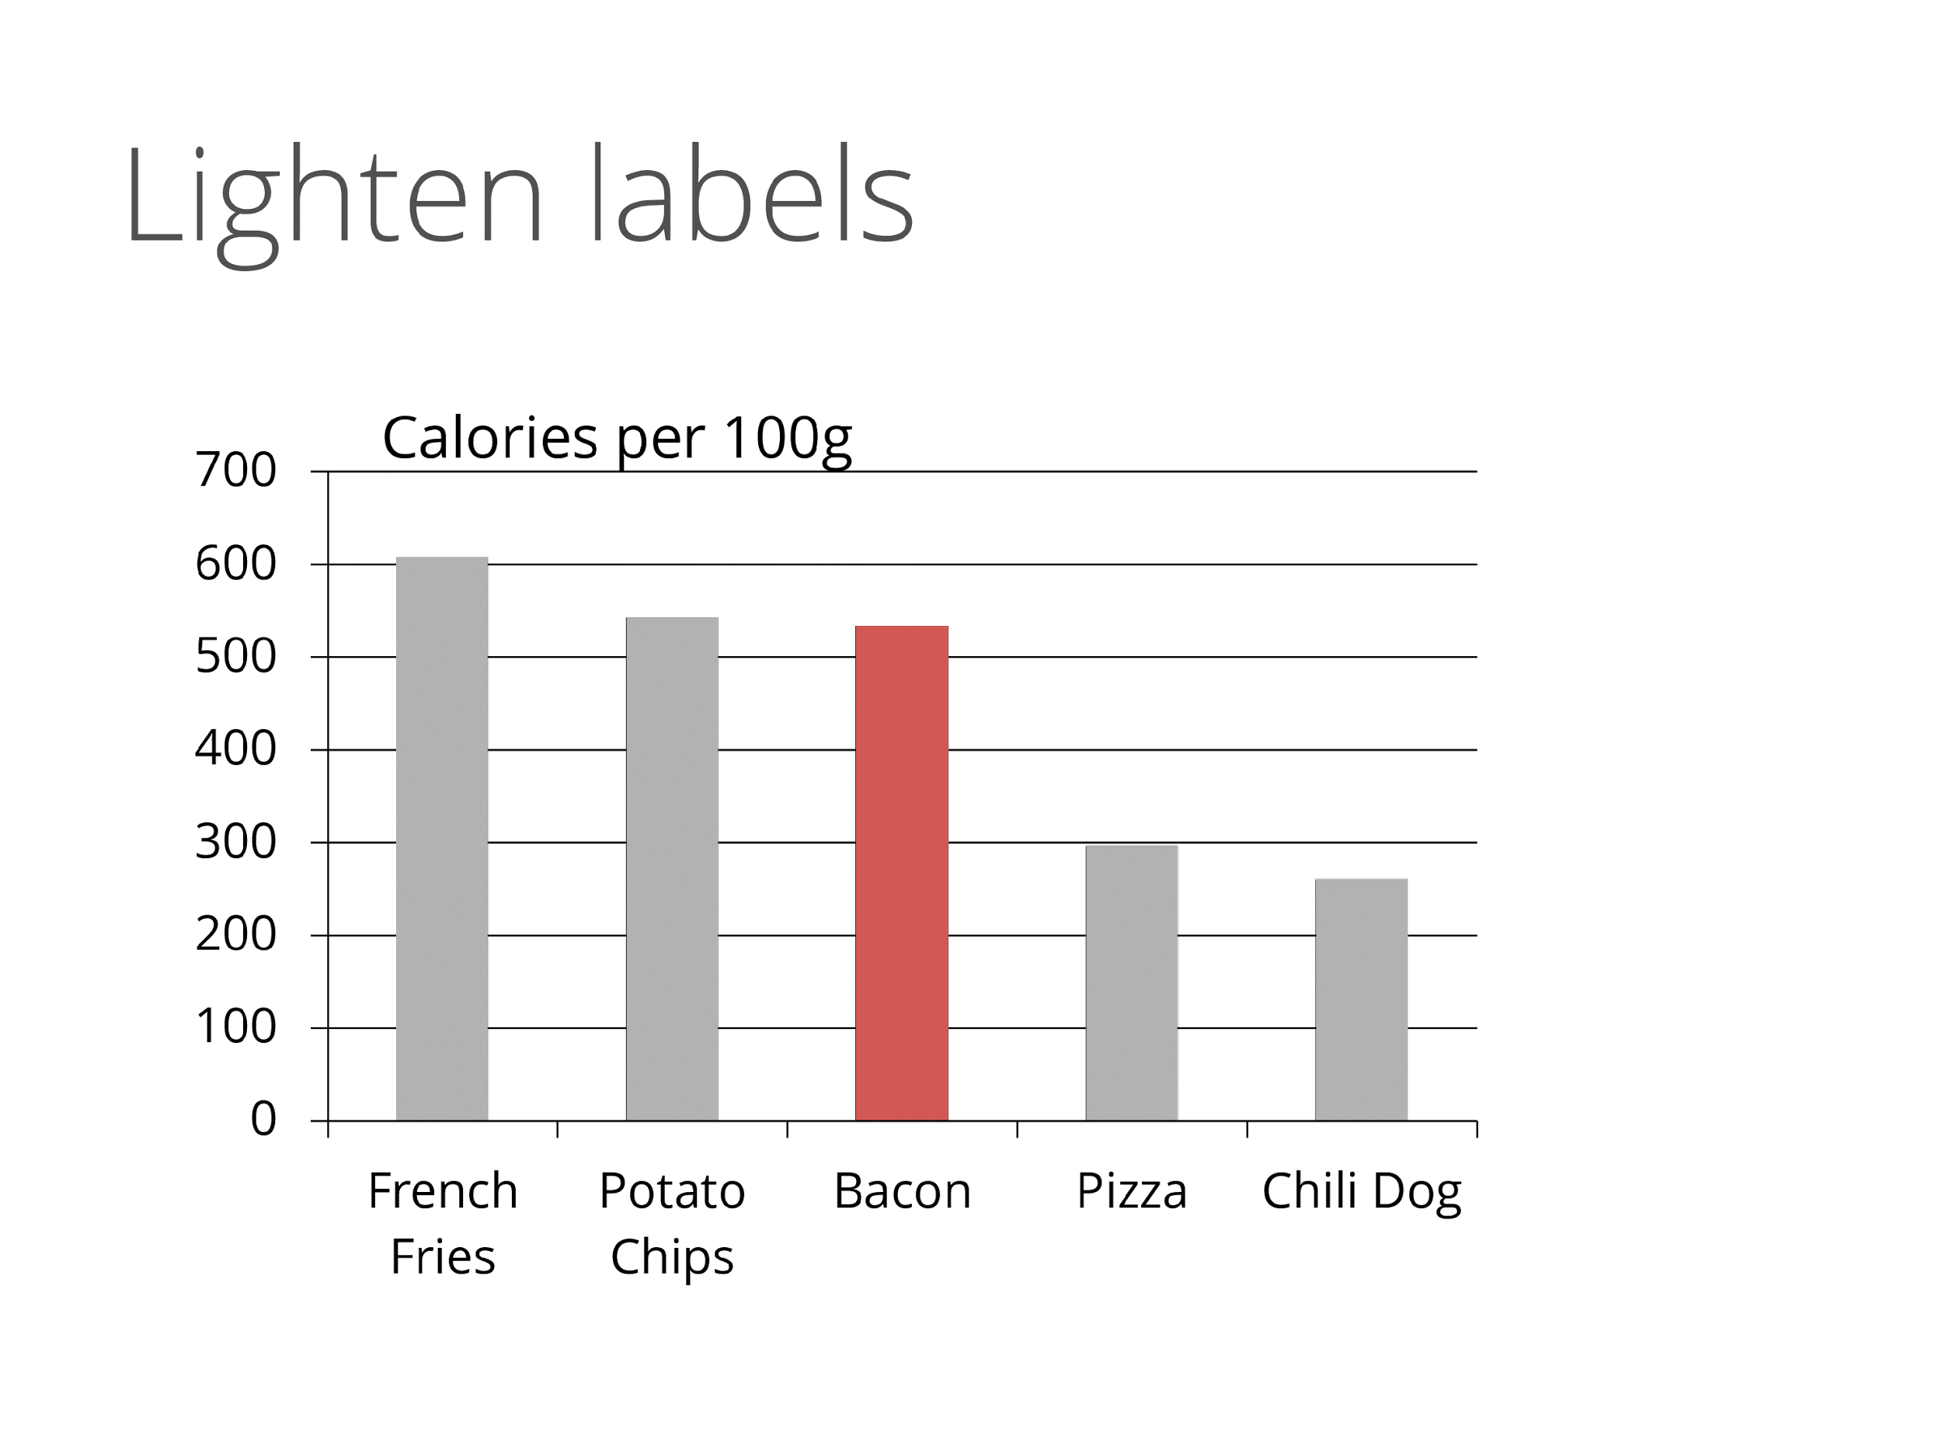
Notes:
Image: Calories per 100 grams for different foods bar graph, with background colors, redundant labels, key, borders, colors, shadows and bold text removed.
The Y-axis shows the number of calories, ranging from 0 at the bottom to 700 at the top. The X-axis shows bars for five types of food, listed in descending order of the number of calories: French fries, potato chips, bacon, pizza, and chili dog. The Bacon bar is highlighted in red.

Slide 18
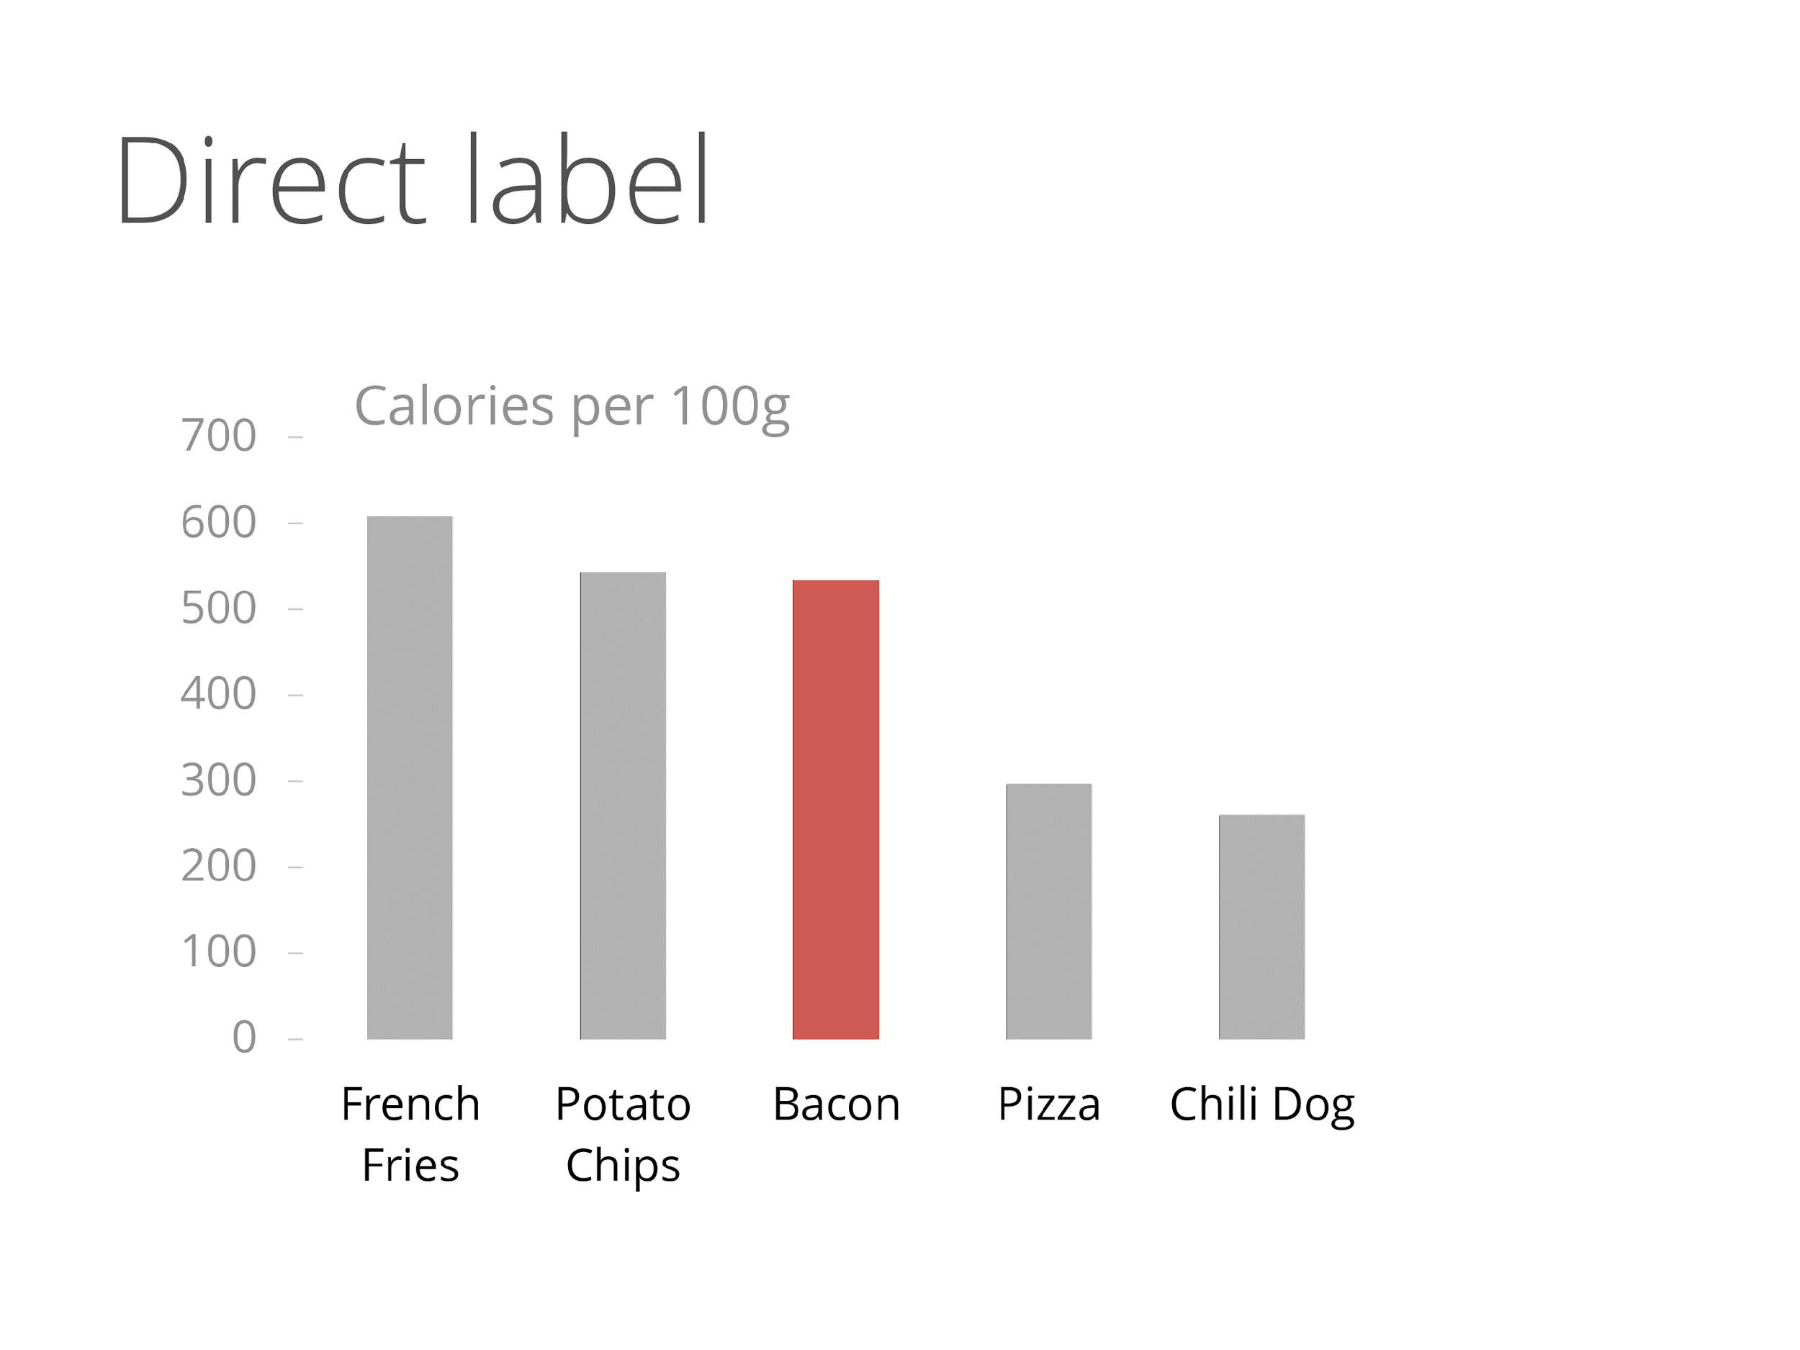
Notes:
Image: Calories per 100 grams for different foods bar graph, with background colors, redundant labels, key, borders, colors, shadows, bold text, and graph lines removed. Labels are lightened.
The Y-axis shows the number of calories, ranging from 0 at the bottom to 700 at the top. The X-axis shows bars for five types of food, listed in descending order of the number of calories: French fries, potato chips, bacon, pizza, and chili dog. The Bacon bar is highlighted in red.

Slide 19
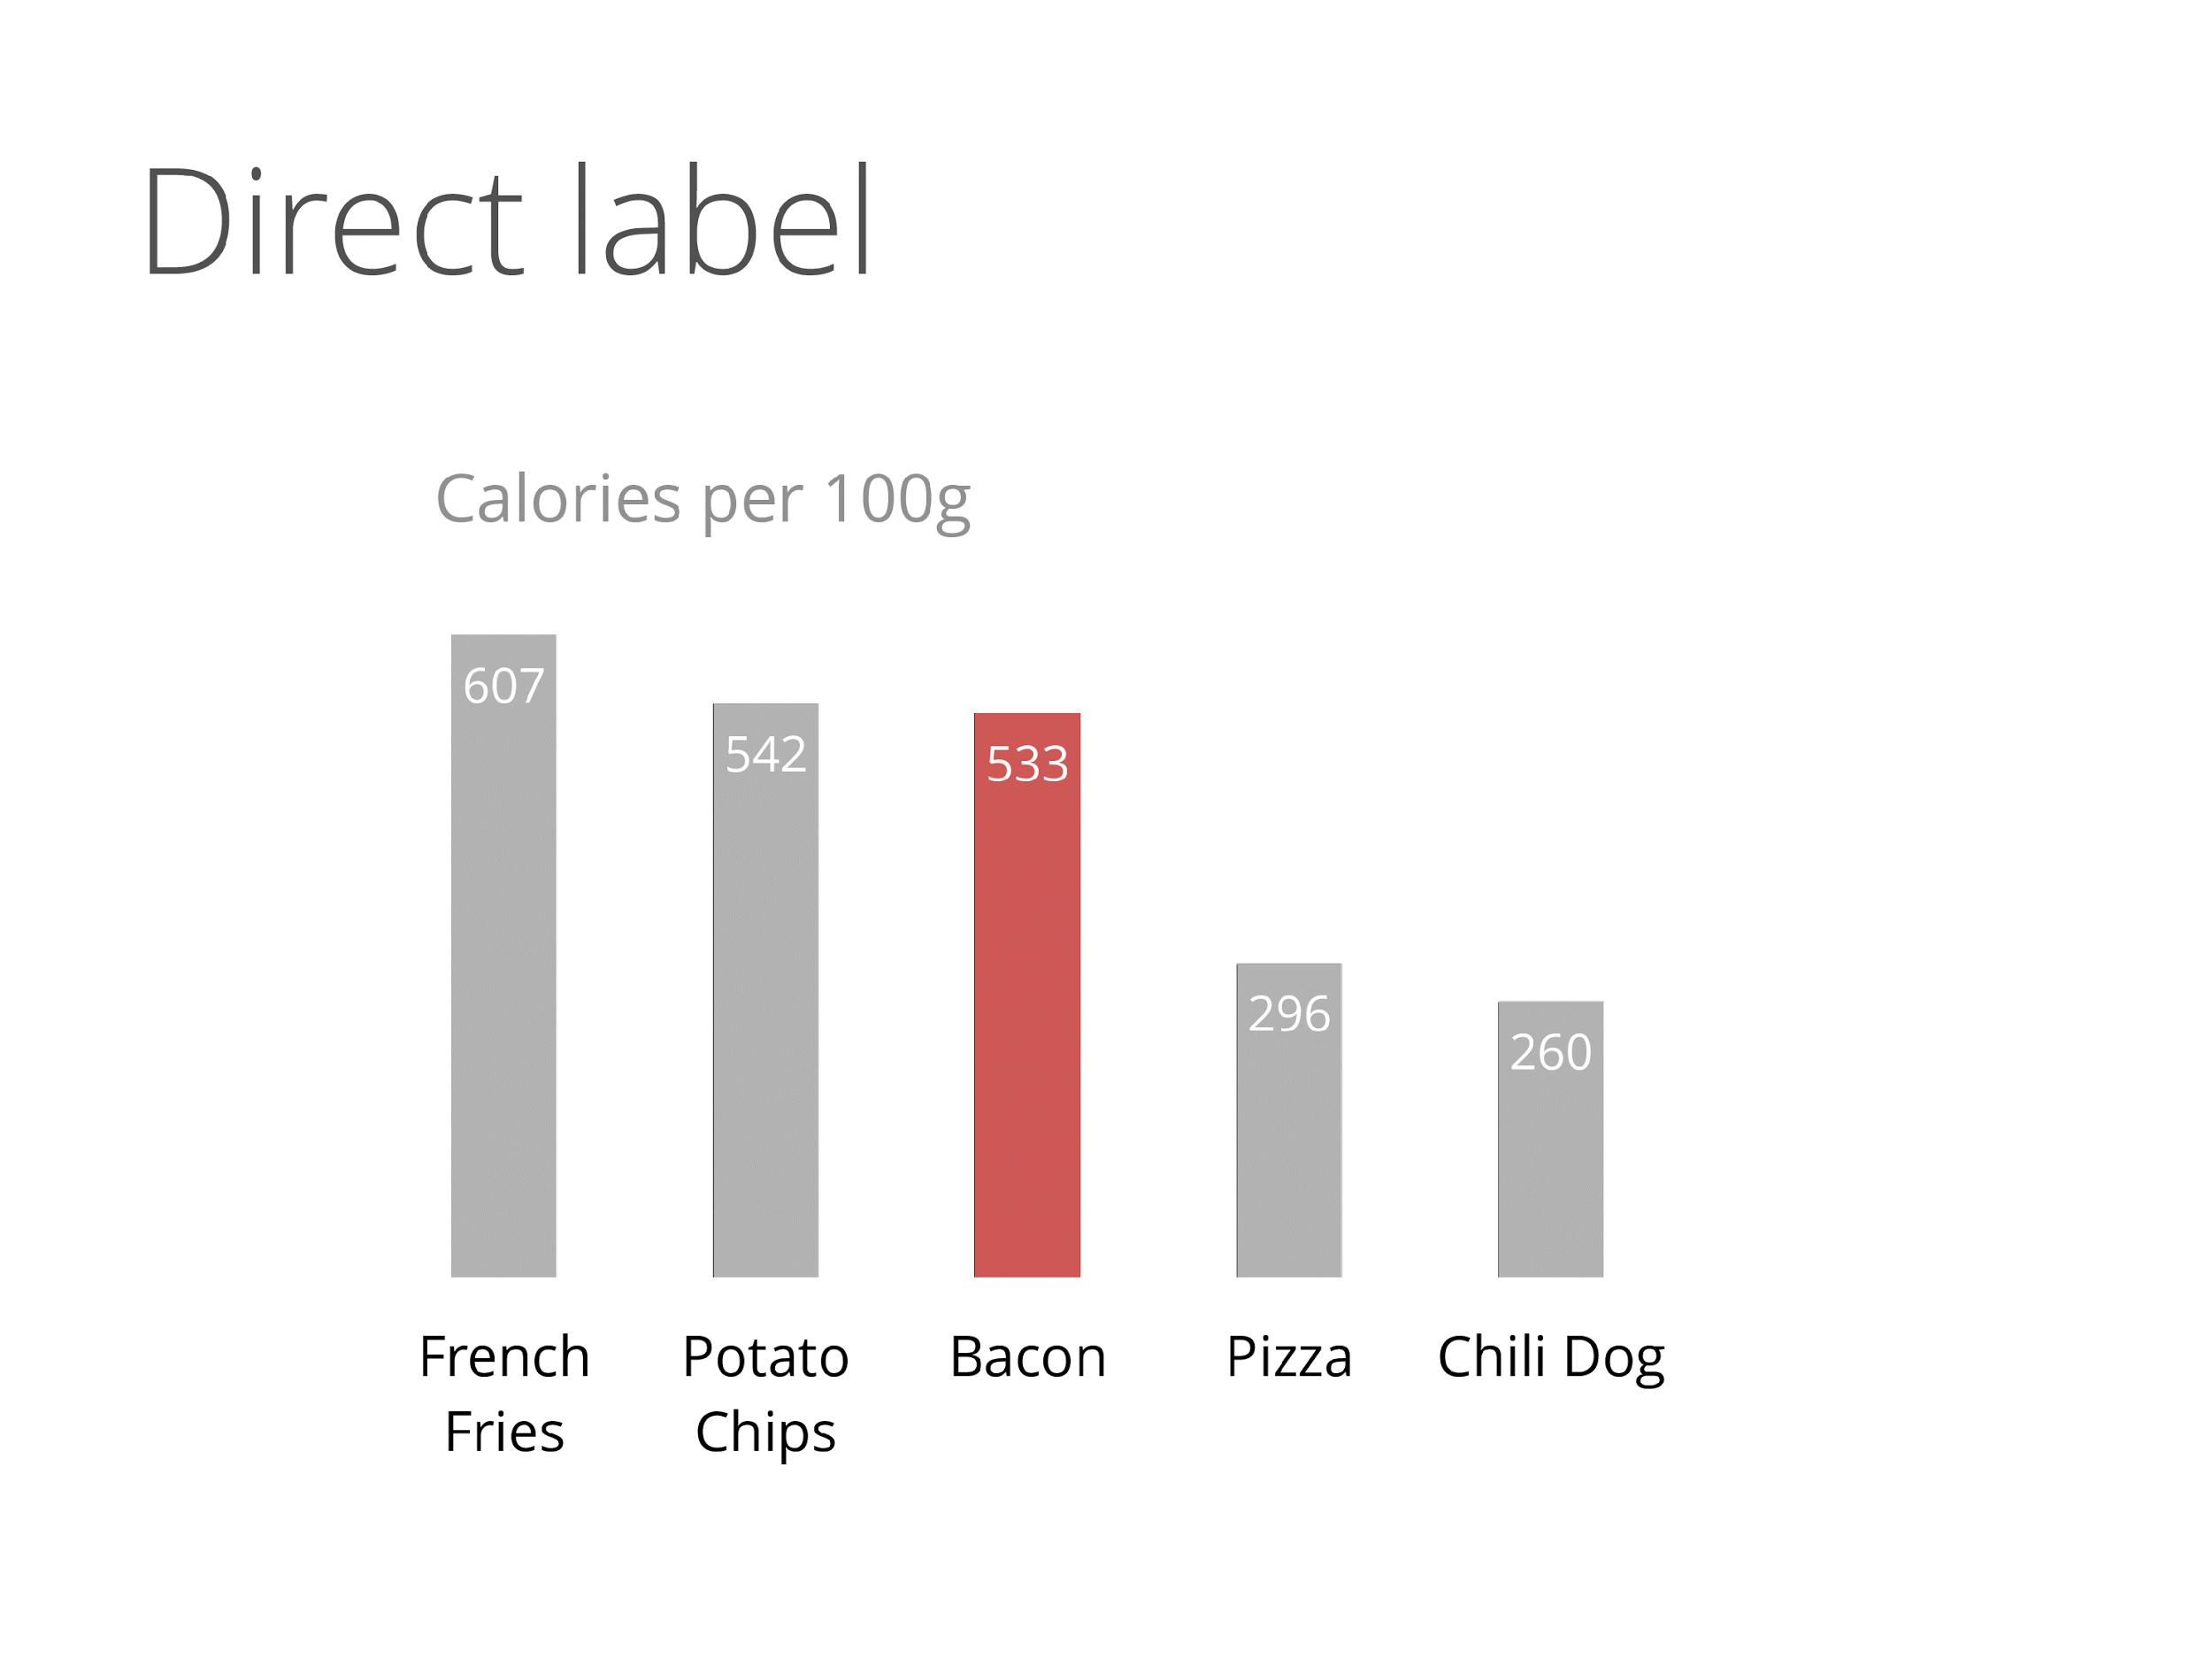
Notes:
Image: Calories per 100 grams for different foods bar graph, with background colors, redundant labels, key, borders, colors, shadows, bold text, graph lines, and axes removed.
Five bars of descending heights are shown, with calories amounts listed in each: French fries, potato chips, bacon, pizza, and chili dog. The Bacon bar is highlighted in red.

Slide 20
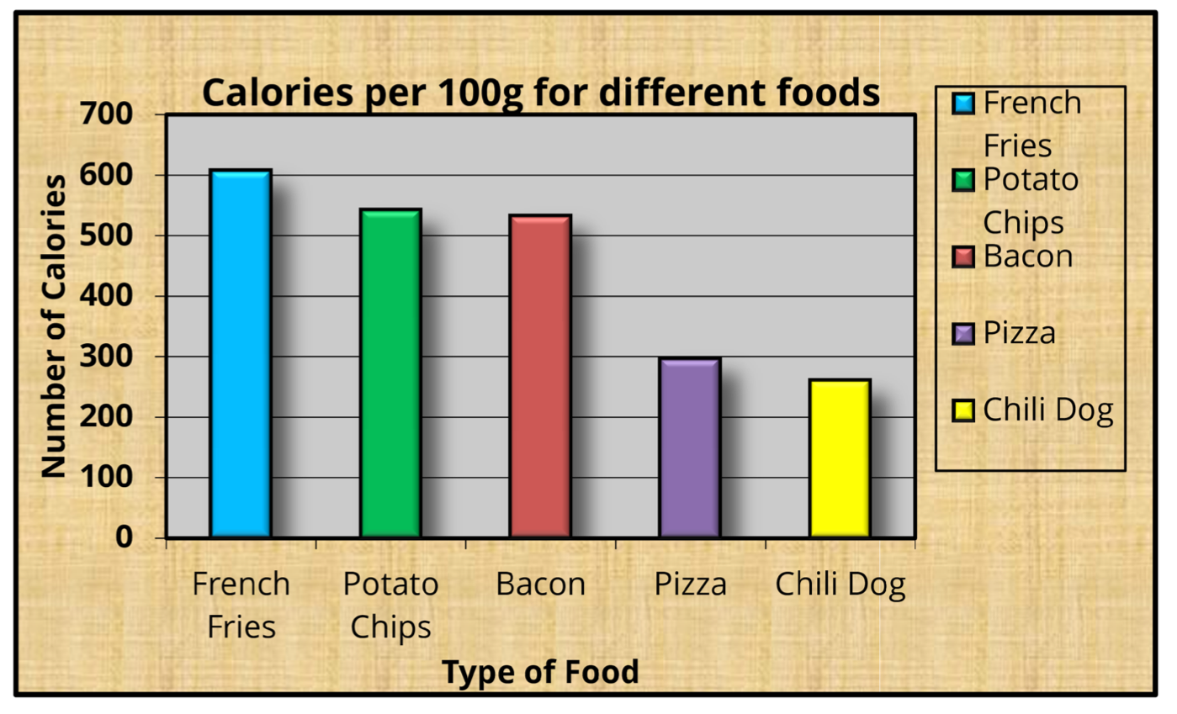
Notes:
Image: Comparison of two images - On the left, the original Calories per 100 grams for different foods bar graph with all background, color, title, and reference text; on the right, the revised version of the same graph: only the Bacon bar is red, the other four bars are grey. The calorie amounts have been labeled directly on the top of each bar.

Slide 21
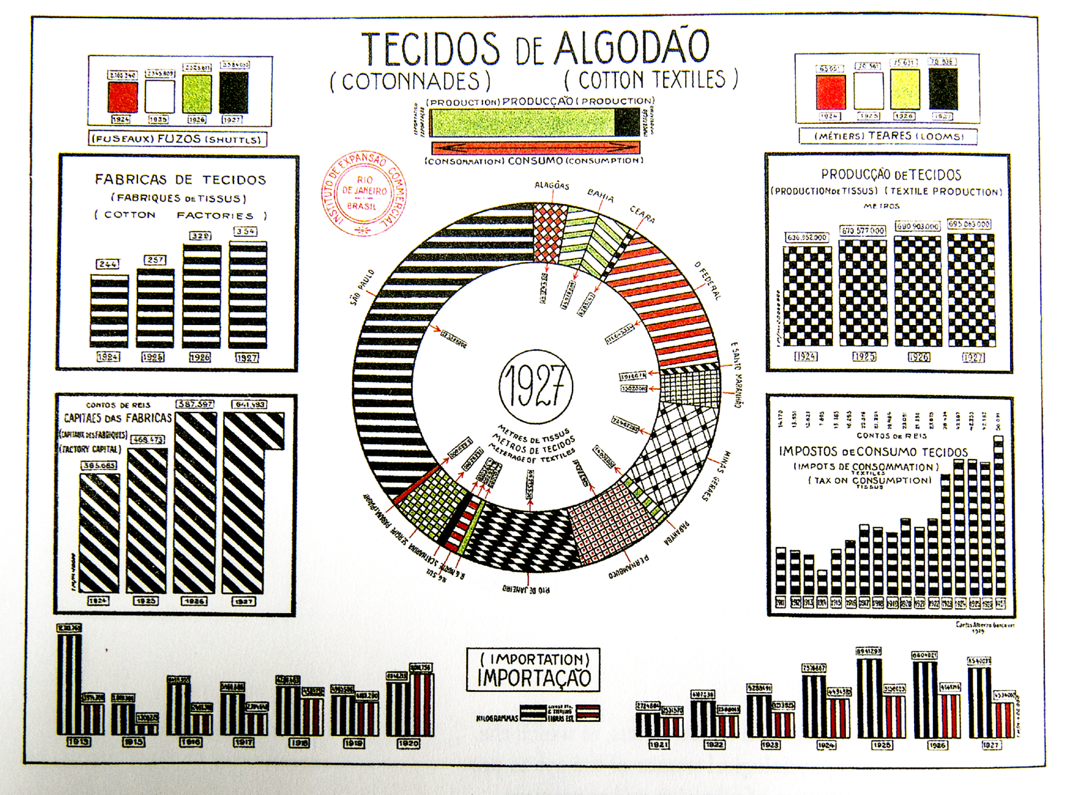
Notes:
Image: Seven sets of data represented by bars with stripes. The compact structure of these graphs in this image easily cause eye fatigue and make people feel bewildered.
[source] Tufte, E. R. (1985). “Instituto de Expansao Commercial, Brasil: ‘Graphicos Economicos-Estisticas’ (Rio de Janeiro, 1929), p 15.” The Visual Display of Quantitative Information. Second Edition. Cheshire, CT: Graphics Press. (pp 108)

Slide 22
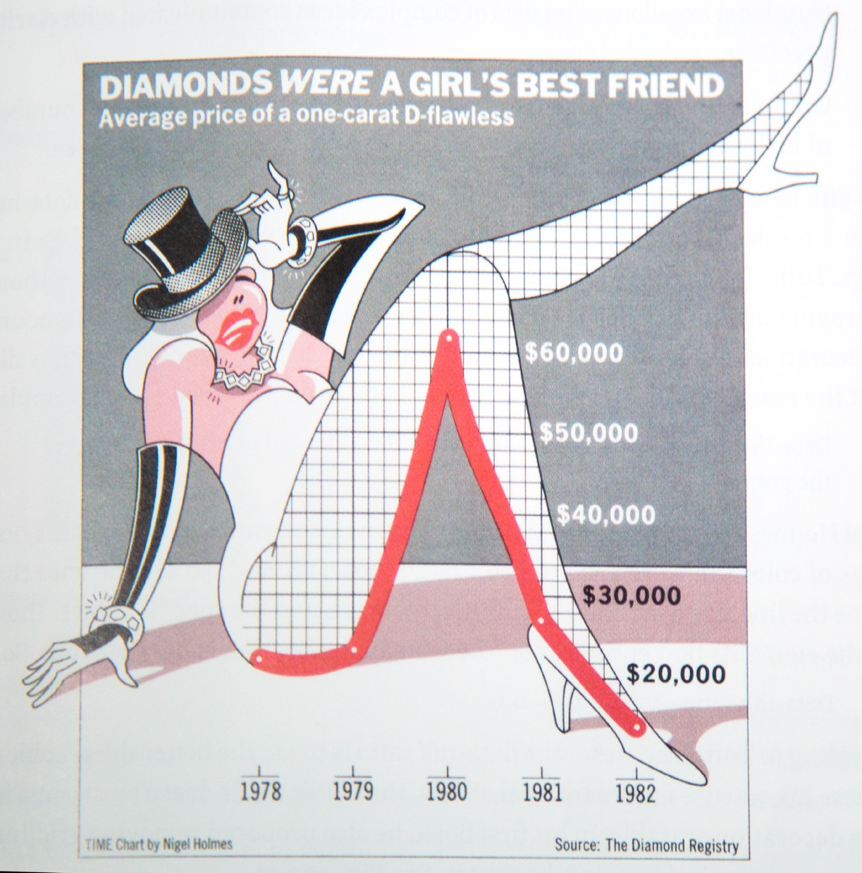
Notes:
Image: Infographic of a woman whose bended leg coincides with the trend of diamond price. From ankle to knee, the price changes from lowest to highest over time.
[source] “Diamonds Were a Girl’s Best Friend” | Nigel Holmes in “A Gem That Lost Its Luster,” Time 120, no. 9 (August 30, 1982) Retrieved February 17, 2017 from http://visualoop.com/media/2015/03/Diamonds-Were-a-Girls-Best-Friend.jpg

Slide 23
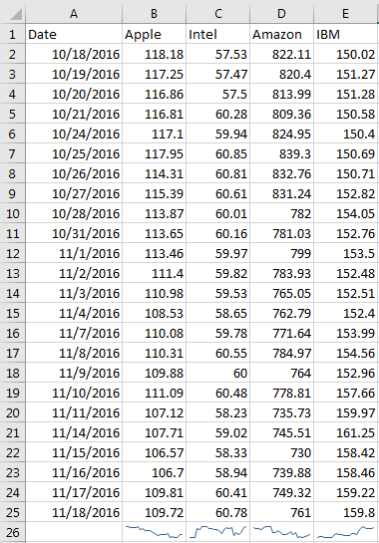
Notes:
Image: Tabular data with rows indicating dates, and columns including Apple, Intel, Amazon, and IBM. There are many numbers and they are listed densely, with no differentiating formatting.

Slide 24
Notes:
Image 1: (Identical to previous table) Tabular data with rows indicating dates, and columns including Apple, Intel, Amazon, and IBM. There are many numbers and they are listed densely, with no differentiating formatting.
Image 2: Similar to previous table, with four sparklines added to the bottom row, showing the monthly trend of each of the four companies.

Slide 25
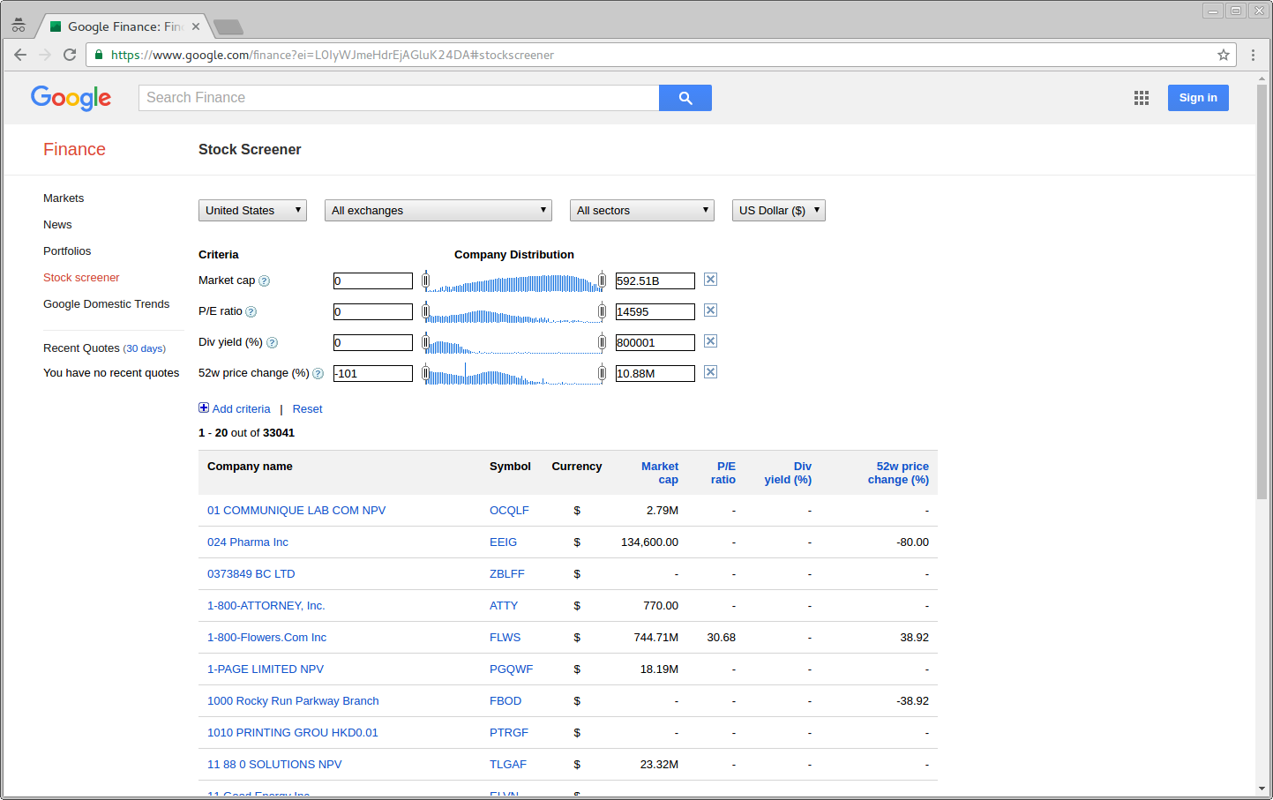
Notes:
Image: A screenshot from the Google Finance website, showing table and data distribution charts with sparklines.
[source] Google Finance. Retrieved February 17, 2017 from https://www.google.com/finance?ei=L0IyWJmeHdrEjAGluK24DA#stockscreener

Slide 26
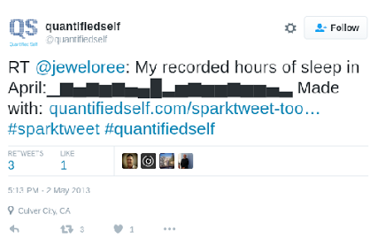
Notes:
Image: Screenshot of twitter, showing user’s recorded hours of sleep in the form of a bar graph by a tool called Quantifiedself. The trend of data change is obvious in the bar graph.
[source] Retrieved February 17, 2017 from twitter.com

Slide 27
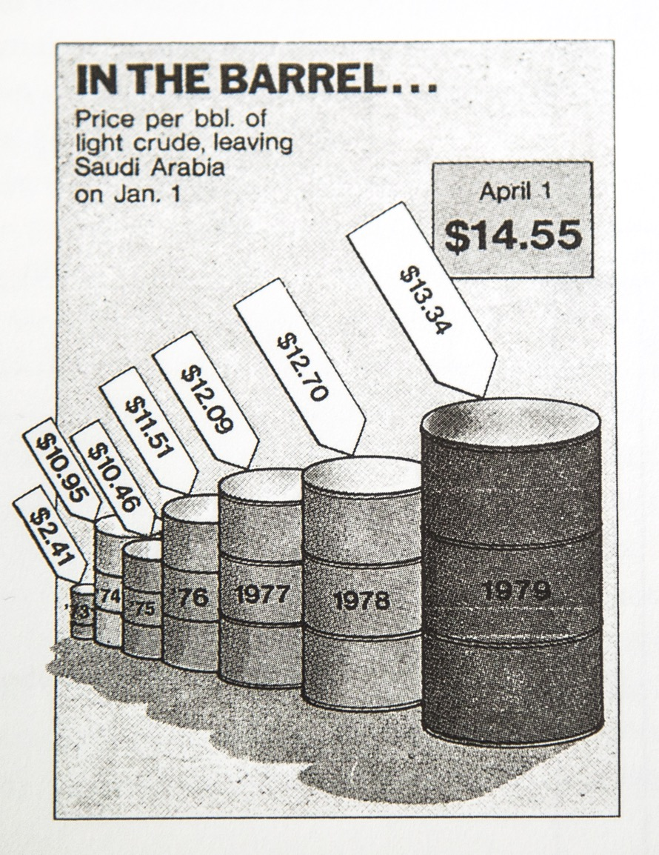
Lie Factor
If you consider volume, the lie factor is 9.4 times the stated prices
Notes:
Image: Illustration showing seven barrels with increasing volume, height, dates, and price tags. They are placed from back to front on a diagonal line. The most current barrel with the higher price has the largest volume and highest height.
[source] Tufte, E. R. (1985). “In the Barrel.” Originally in Time, April 9, 1979, 57. The Visual Display of Quantitative Information. Second Edition. Cheshire, CT: Graphics Press. (pp 62) Retrieved February 17, 2017 from http://images.slideplayer.com/14/4283310/slides/slide_10.jpg for digital copy.

Slide 28
Qualities of a Great Visualization
Truthful
Be aware of your actions when cleaning, summarizing and manipulating data and ensure you aren’t
Misleading yourself (self deception)
Misleading your audience

Slide 29
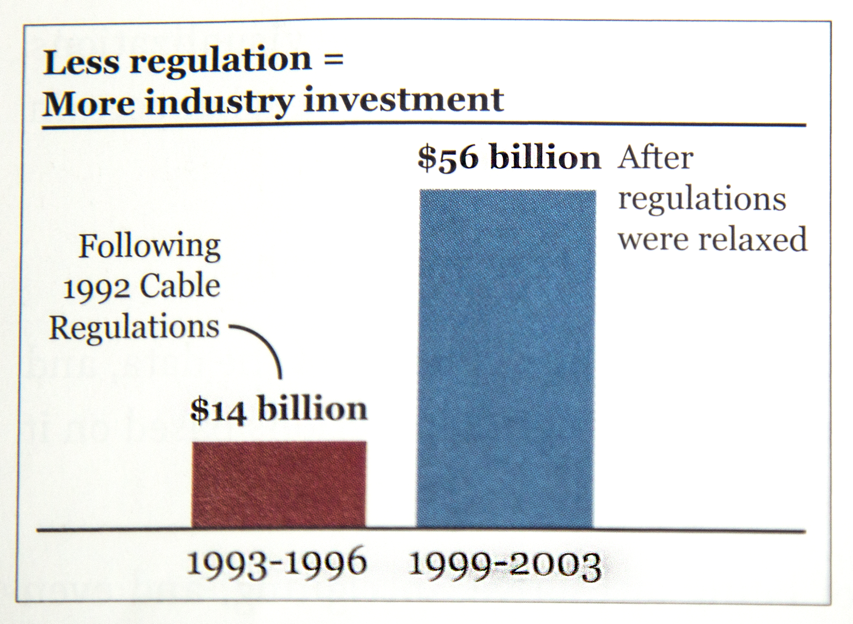
Notes:
Image: A histogram showing industry investment from 1993-1996 following the 1992 cable regulations, which was 14 billion dollars, and the 56 billion dollar investment in 1999-2003 after the regulations were relaxed.
[source] Cairo, A. (2016). The truthful art: Data charts and maps for communication. Berkley, CA: New Riders. (Figure 2.2, pp 46)

Slide 30

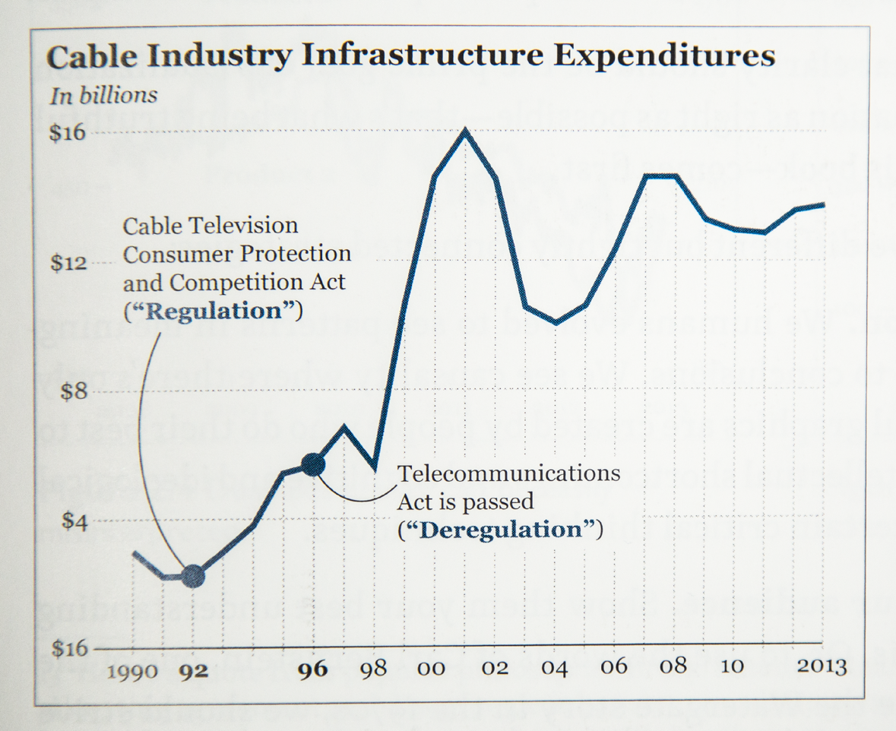
Notes:
Image 1: A histogram showing industry investment from 1993-1996 following the 1992 cable regulations, which was 14 billion dollars, and the 56 billion dollar investment in 1999-2003 after the regulations were relaxed.
[source] Cairo, A. (2016). The truthful art: Data charts and maps for communication. Berkeley, CA: New Riders. (Figure 2.2, pp 46)
Image 2: A line graph showing the trend of cable industry infrastructure expenditures from 1990 to 2013. This graph completes the information of expenditures in the years missed from the previous graph (1996-1999).
[source] Cairo, A. (2016). The truthful art: Data charts and maps for communication. Berkley, CA: New Riders. (Figure 2.3, pp 47)

Slide 31
Qualities of a Great Visualization
Truthful
Be aware of your actions when cleaning, summarizing and manipulating data and ensure you aren’t
Misleading yourself (self deception)
Misleading your audience
Functionality

Slide 32
Notes:
Image 1: Revised Calories per 100 grams for different foods bar graph, with background lines and X-Y axes remaining.
Image 2: Revised Calories per 100 grams for different foods bar graph, with background liens and X-Y axes removed. Data is directly labeled within the bars, making this graph easier to read.

Slide 33
Qualities of a Great Visualization
Truthful
Be aware of your actions when cleaning, summarizing and manipulating data and ensure you aren’t
Misleading yourself (self deception)
Misleading your audience
Functionality
Beauty

Slide 34
Qualities of a Great Visualization
Truthful
Be aware of your actions when cleaning, summarizing and manipulating data and ensure you aren’t
Misleading yourself (self deception)
Misleading your audience
Functionality
Beauty
Insightful

Slide 35
Qualities of a Great Visualization
Truthful
Be aware of your actions when cleaning, summarizing and manipulating data and ensure you aren’t
Misleading yourself (self deception)
Misleading your audience
Functionality
Beauty
Insightful
Enlightening
A combination of the previous four, but with a social ethical responsibility

Slide 36
Acknowledgements
Slide1:
Cairo, A. (2013). The functional art: An introduction to information graphics and visualization. Berkeley, CA: New Riders.
Slide 5:
Ho, A. D., Reich, J., Nesterko, S., Seaton, D. T., Mullaney, T., Waldo, J., & Chuang, I. (2014). HarvardX and MITx: The first year of open online courses (HarvardX and MITx Working Paper No. 1). Retrieved February 17, 2017 from https://papers.ssrn.com/sol3/papers.cfm?abstract_id=2381263 for digital copy. (Figure 13, p 31)

Slide 37
Acknowledgements
Slide 7:
“Charles Minard's map of Napoleon's disastrous Russian campaign of 1812.” Retrieved February 17, 2017 https://en.wikipedia.org/wiki/Charles_Joseph_Minard#/media/File:Minard.png
Slide 9:
Cairo, A. (2013). The functional art: an Introduction to information graphics and visualization. Berkley, CA: New Riders. (Figure 3.11, pp 62)

Slide 38
Acknowledgements
Slide 10:
Tufte, E. R. (1985). The Visual Display of Quantitative Information. Cheshire, CT: Graphics Press.
Slide 11
Retrieved February 17, 2017, from http://www.darkhorseanalytics.com/

Slide 39
Acknowledgements
Slide 21
Tufte, E. R. (1985). “Instituto de Expansao Commercial, Brasil: ‘Graphicos Economicos-Estisticas’ (Rio de Janeiro, 1929), p 15.” The Visual Display of Quantitative Information. Second Edition. Cheshire, CT: Graphics Press. (pp 108)
Slide 22
“Diamonds Were a Girl’s Best Friend” | Nigel Holmes in “A Gem That Lost Its Luster,” Time 120, no. 9 (August 30, 1982) Retrieved February 17, 2017 from http://visualoop.com/media/2015/03/Diamonds-Were-a-Girls-Best-Friend.jpg

Slide 40
Acknowledgements
Slide 25
Google Finance. Retrieved February 17, 2017 from https://www.google.com/finance?ei=L0IyWJmeHdrEjAGluK24DA#stockscreener
Slide 26
Retrieved February 17, 2017 from twitter.com

Slide 41
Acknowledgements
Slide 27
Tufte, E. R. (1985). “In the Barrel.” Originally in Time, April 9, 1979, 57. The Visual Display of Quantitative Information. Second Edition. Cheshire, CT: Graphics Press. (pp 62) Retrieved February 17, 2017 from http://images.slideplayer.com/14/4283310/slides/slide_10.jpg for digital copy.
Slide 29
Cairo, A. (2016). The truthful art: Data charts and maps for communication. Berkley, CA: New Riders. (Figure 2.2, pp 46)

Slide 42
Acknowledgements
Slide 30
Image on the left:
Cairo, A. (2016). The truthful art: Data charts and maps for communication. Berkeley, CA: New Riders. (Figure 2.2, pp 46)
Image on the right
Cairo, A. (2016). The truthful art: Data charts and maps for communication. Berkley, CA: New Riders. (Figure 2.3, pp 47)

